Slide 1
Item Parameter Estimation “Calibration”
EDUC 8720
February 2023

Slide 2
Overview
JMLE
Simultaneously estimate person thetas and item parameters.
Works iteratively, going back and forth.
Conceptually simple, has practical problems, no longer widely used.
MMLE
Marginal maximum likelihood assumes a particular distribution of theta, then estimates only item parameters (no thetas).
More complicated, but has better statistical properties and is now widely used.
CMLE
Conditional maximum likelihood also only used to estimate item parameters.
Only works for Rasch models, where total score is a sufficient statistic for theta.

Slide 3
Joint Maximum Likelihood Estimation (JMLE)
Conceptual overview:
Specify functional form of ICC.
Write out the Joint Likelihood Function (over both items and persons).
Take the Log of the Likelihood Function.
Establish “Estimating Equations” for Item and Person Parameters respectively. [Take partial derivatives]
Start with provisional theta values and get estimates for item parameters. [Newton-Raphson Algorithm]
Use item parameter estimates to get new estimates of theta’s. [Newton-Raphson Algorithm]
Repeat steps 5 and 6 until convergence criterion is reached (usually something like .01 on logit scale).
Iterative process that goes back and forth between items and theta’s. Results in an estimate of theta for each person and item parameters for each item.

Slide 4
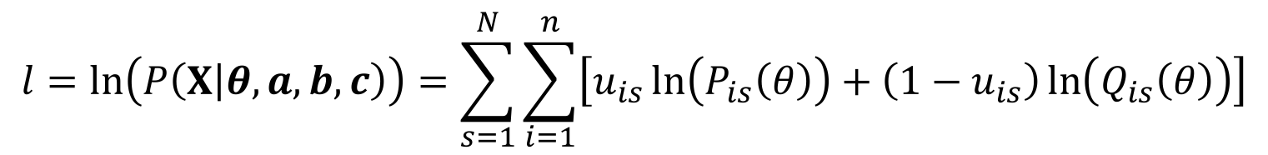
Log of Joint Likelihood Function
$$l=\ln\left(P\left(X | θ, a, b,c\right)\right)=\sum_{s=1}^{N}{\sum_{i=1}^{n}{\left[u_{is}\ln\left(P_{is}\left(θ\right)\right)+\left(1−u_{is}\right)\ln\left(Q_{is}\left(θ\right)\right)\right]}}$$
Next step would be to take the partial derivatives of the log-likelihood function above with respect to (a) each item parameter and (b) each person parameter, and set these equations equal to 0. Then need to solve all equations simultaneously.
Say we have 10 items.
If you specified a 1PL model, how many estimating equations would you have to solve? 2PL? 3PL?
How many equations in total if you have 1000 respondents? 2000?
Notes:
Note: I prefer this form to the one shown in ER p. 202 where they have taken log for respondents but not for items. Should have two summation symbols.

Slide 5
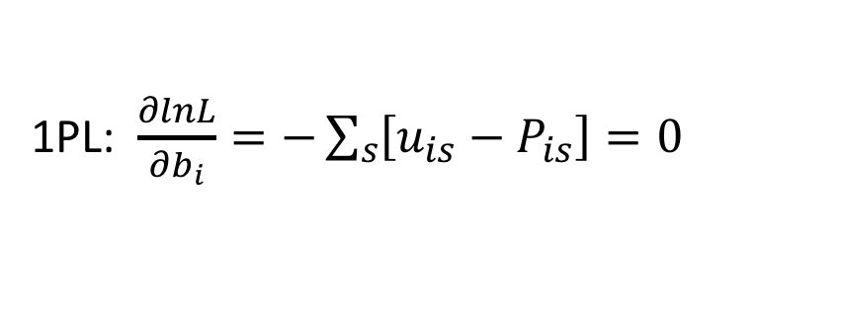
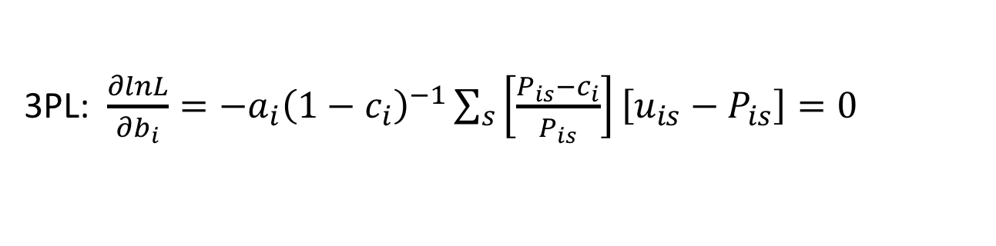
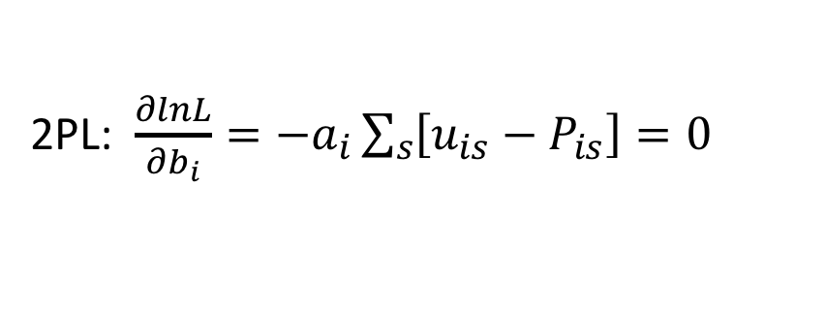
JML Estimation Eqns for Item Difficulty
Observed Item Response
Expected Item Response
1PL: $\frac{∂lnL}{∂b_{i}}=−\sum_{s}{\left[u_{is}−P_{is}\right]=0}$
2PL: $\frac{∂lnL}{∂b_{i}}=−a_{i}\sum_{s}{\left[u_{is}−P_{is}\right]=0}$
3PL: $\frac{∂lnL}{∂b_{i}}=−a_{i}{\left(1−c_{i}\right)}^{−1}\sum_{s}{\left[\frac{P_{is}−c_{i}}{P_{is}}\right]\left[u_{is}−P_{is}\right]=0}$
The task is to solve these equations for the value of b_{i} that that gets the difference between expected and observed item responses over all respondents as small as possible. Notice increase in complexity from 1PL to 3PL, and the involvement is other item parameters.

Slide 6
Complications
For 2PL estimation eqns there will be
3 first partial derivatives (a, b, theta)
6 second order partial derivatives (a, b, theta and cross-products)
Using Newton-Raphson technique becomes more intensive. Here is the expression in matrix format
2nd Derivative
1st Derivative
2n + N
(2n + N)
(2n + N) x (2n + N)

Slide 7
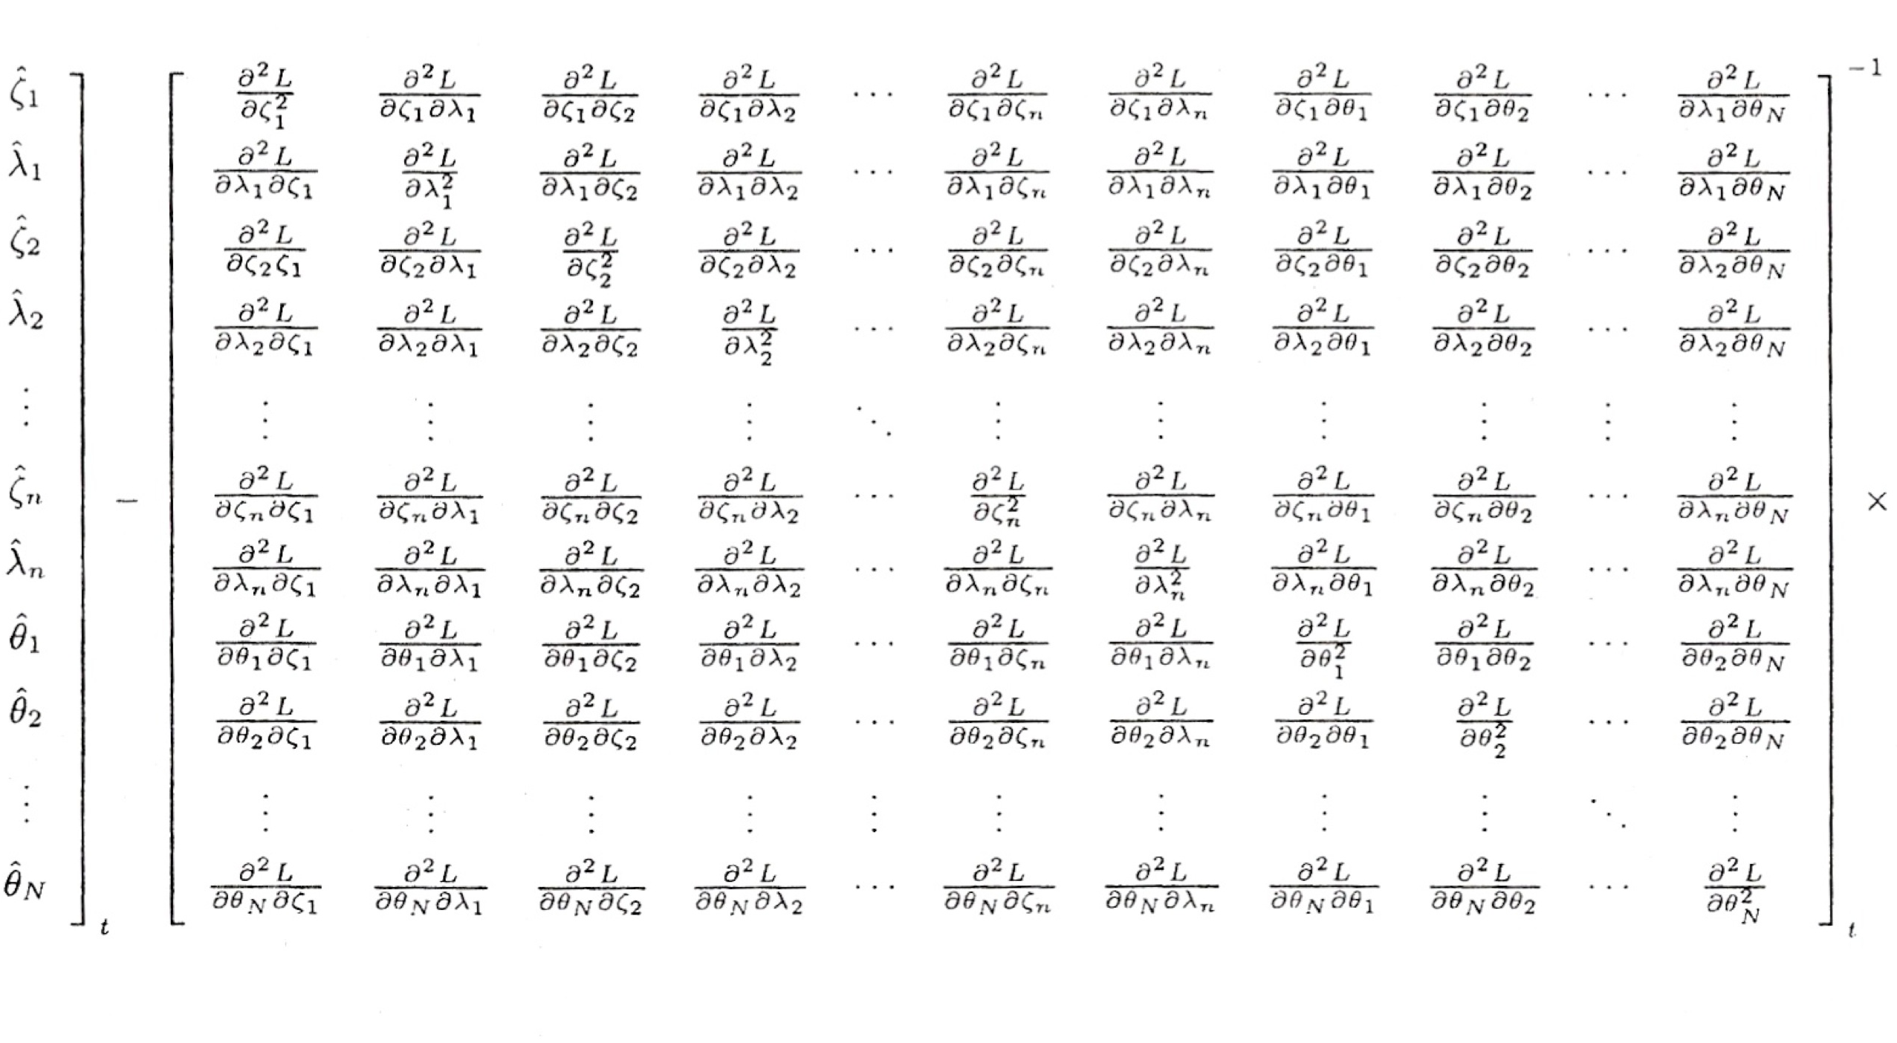
The Full Hessian (i.e., “B”) (Matrix of 2nd Derivatives)

Slide 8
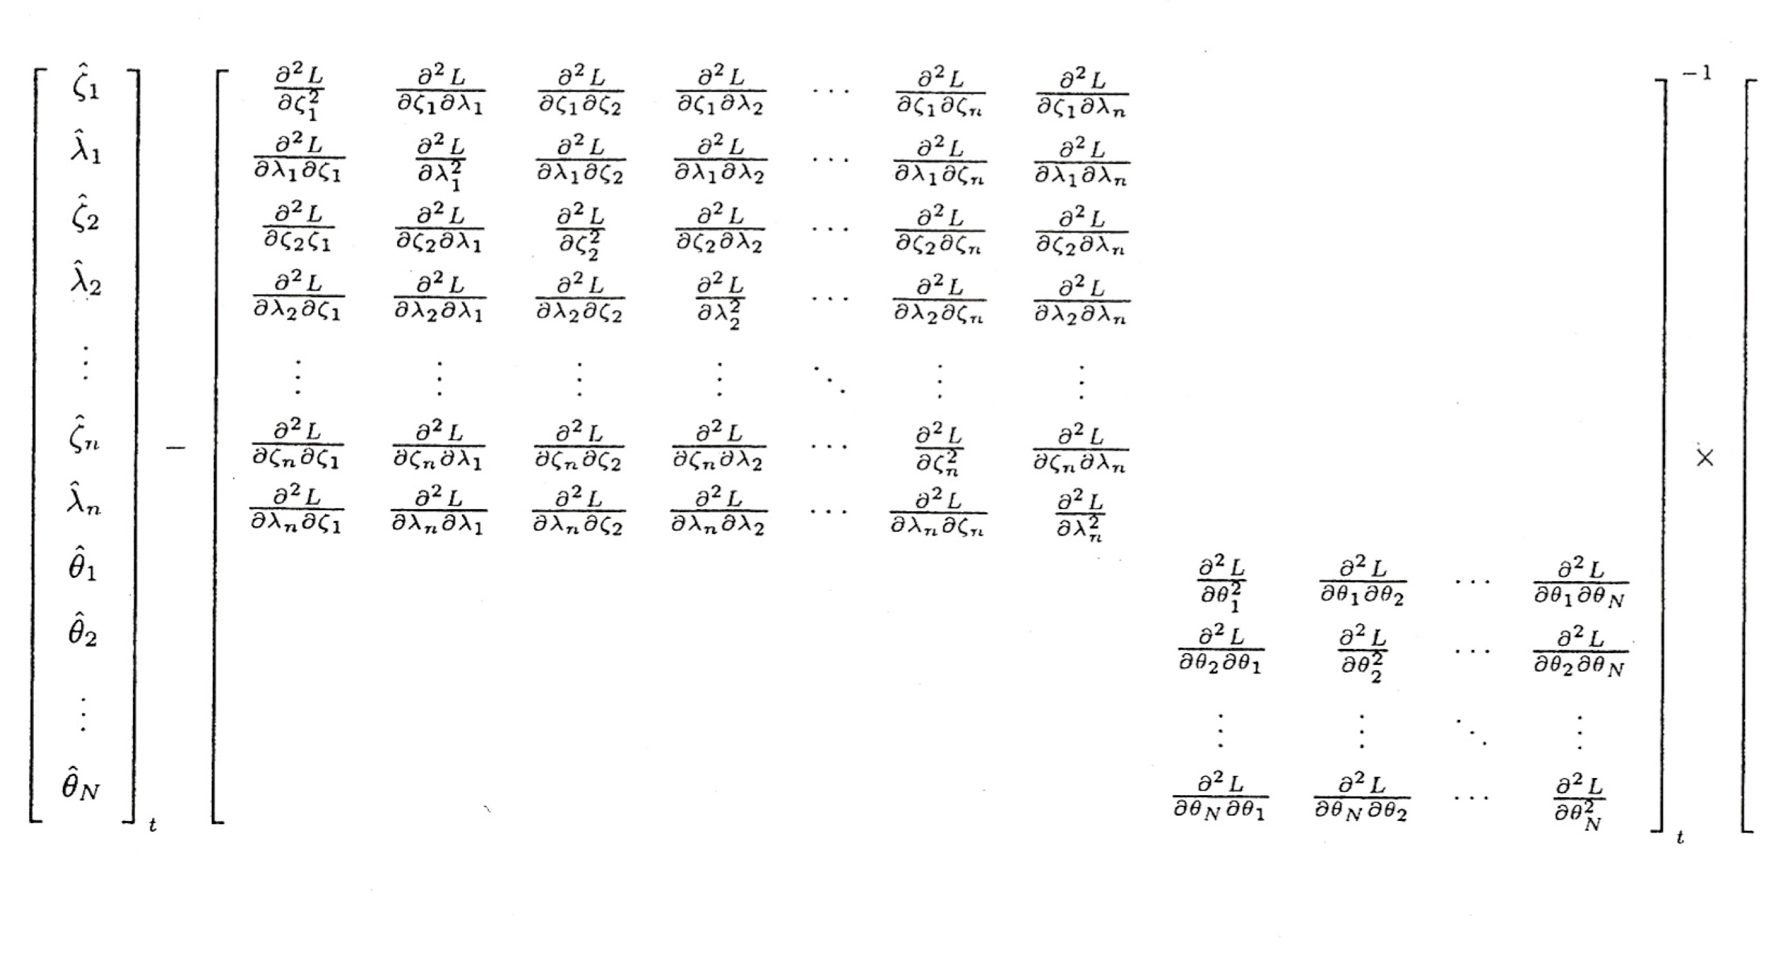
Simplifying Assumptions
Examinee ability and item parameters are independent

Slide 9
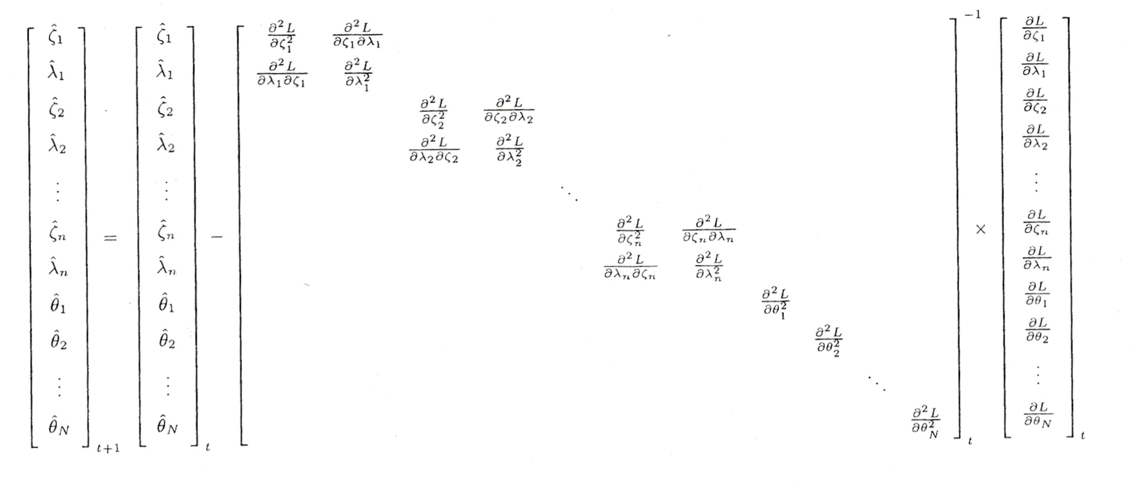
Even Better…
Examinees are sampled at random
Local indepedence

Slide 10
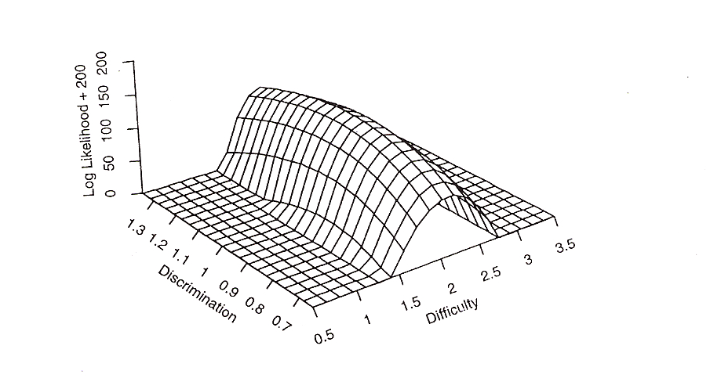
Estimation Challenges: 2PL
Notice: Now we are looking for maximum of the function with respect to two parameters along the “ridge” above. Which item parameter will be “easier” to estimate in the scenario above?
Source: Baker & Kim, p. 45

Slide 11
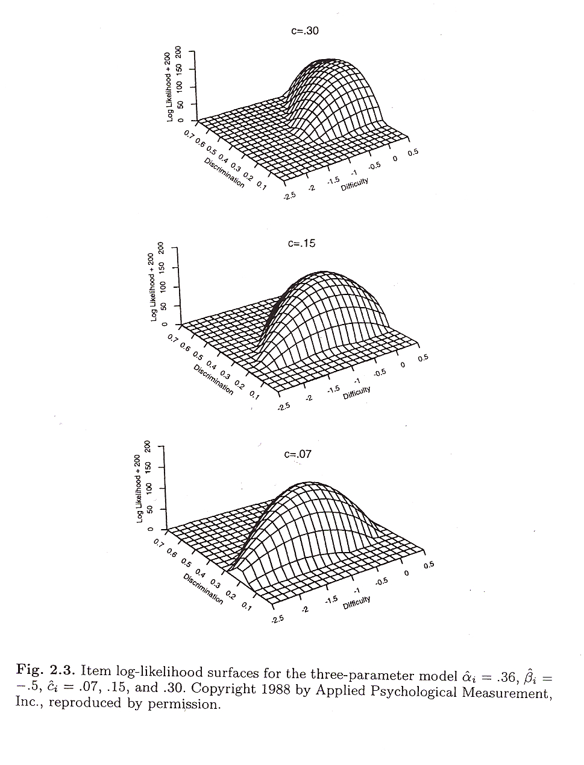
Estimation Challenges: 3PL
Things Get Even More Complicated when the “Guessing” Parameter is Introduced.
NR does not converge rapidly and solution can be very dependent on starting values.
Finding the maximum wrt to c parameter is very hard, and including c parameter has impact on estimation equations for a and b as well.
Source: Baker & Kim, p. 54

Slide 12
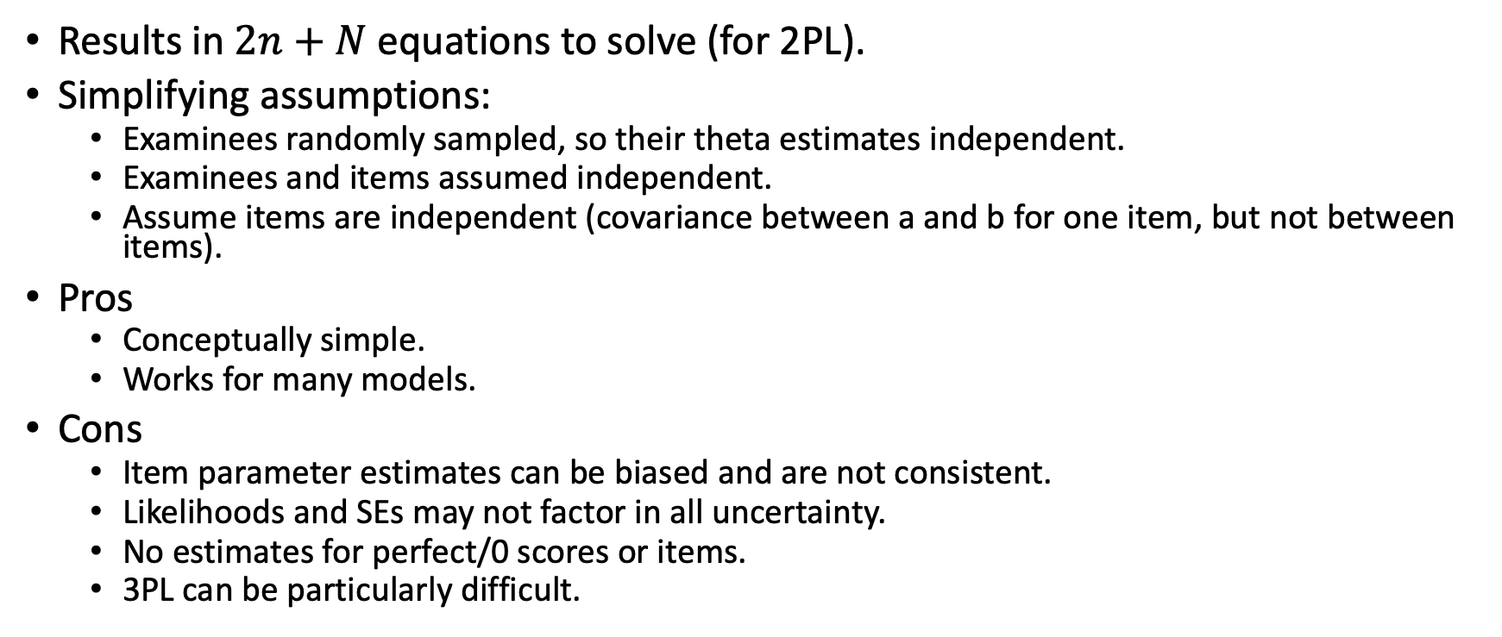
JMLE Notes
Results in $2n+N$ equations to solve (for 2PL).
Simplifying assumptions:
Examinees randomly sampled, so their theta estimates independent.
Examinees and items assumed independent.
Assume items are independent (covariance between a and b for one item, but not between items).
Pros
Conceptually simple.
Works for many models.
Cons
Item parameter estimates can be biased and are not consistent.
Likelihoods and SEs may not factor in all uncertainty.
No estimates for perfect/0 scores or items.
3PL can be particularly difficult.

Slide 13
Marginal Maximum Likelihood Estimation (MMLE)
Conceptual overview:
Specify functional form of ICC.
Compute the Joint Likelihood Function (over persons and items) and combine with a pdf (like a prior) for theta.
Integrate (i.e., take average) over theta to get marginal likelihood function.
Take the Log of the Marginal Likelihood Function.
Establish set of estimating equations by item for each item parameter of interest. [Partial Derivatives]
Numerical Integration using Quadrature points.
EM (“expectation maximization”) Algorithm to find maximums.
This is also an iterative procedure to find best set of item parameter estimates, but it never produces person theta estimates.

Slide 14
Key Pieces Needed to Understand MMLE
Marginal likelihood
Using quadrature to approximate an integral
Quadrature form of posterior distribution
Quadrature form of estimating equations

Slide 15
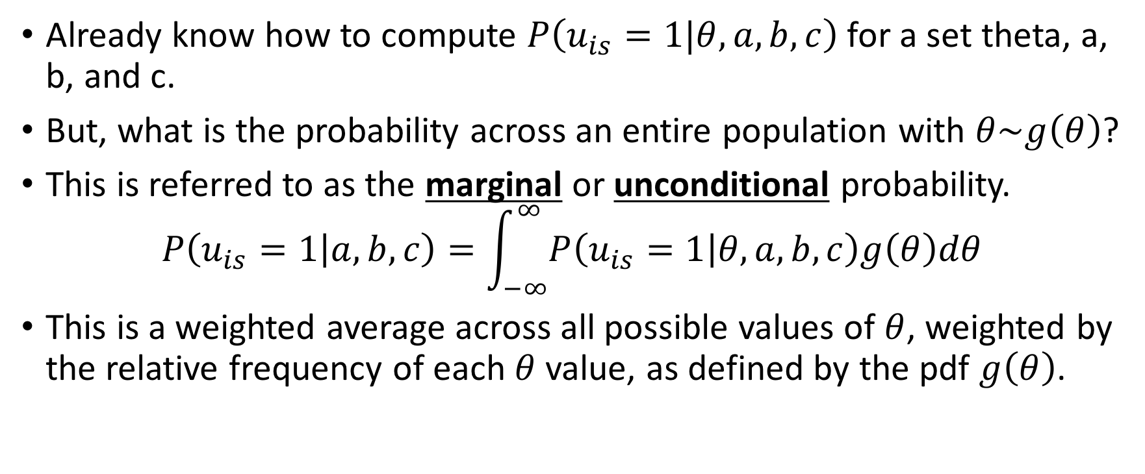
Marginal Probability
Already know how to compute $P\left(u_{is}=1|θ,a,b,c\right)$ for a set theta, a, b, and c.
But, what is the probability across an entire population with $θ\sim g\left(θ\right)$?
This is referred to as the marginal or unconditional probability.
$$P\left(u_{is}=1 | a,b,c\right)=\int_{−∞}^{∞}{P\left(u_{is}=1 | θ,a,b,c\right)g\left(θ\right)dθ}$$
This is a weighted average across all possible values of $θ$, weighted by the relative frequency of each $θ$ value, as defined by the pdf $g\left(θ\right)$.

Slide 16
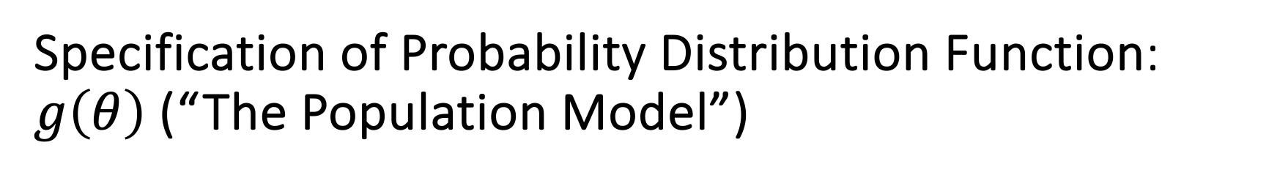
Specification of Probability Distribution Function: $g\left(θ\right)$ (“The Population Model”)
The default convention is to specify a normal pdf
Hence there are now just two parameters specific to the distribution of ability: the mean and variance
But even this is typically “hidden” because when N ~ (0,1) this serves to identify the scale for the a and b item parameters (default in mirt)
MMLE tends to be relatively robust to mild to moderate violations of the normality assumption
It is also possible to specific a different pdf

Slide 17
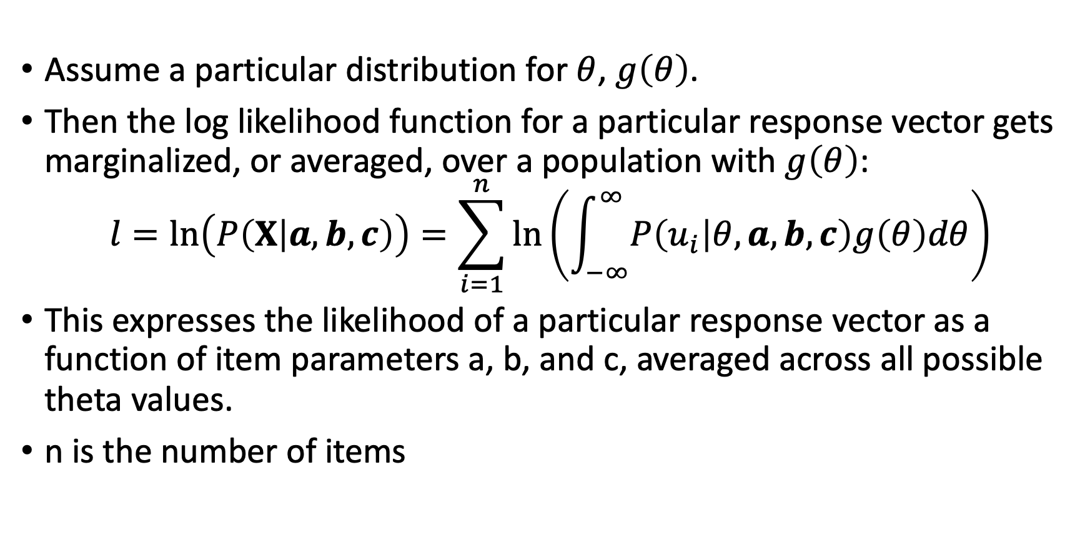
Marginal Likelihood
Assume a particular distribution for $θ$, $g\left(θ\right)$.
Then the log likelihood function for a particular response vector gets marginalized, or averaged, over a population with $g\left(θ\right)$:
$$l=\ln\left(P\left(X | a,b,c\right)\right)=\sum_{i=1}^{n}{\ln\left(\int_{−∞}^{∞}{P\left(u_{i} | θ,a,b,c\right)g\left(θ\right)dθ}\right)}$$
This expresses the likelihood of a particular response vector as a function of item parameters a, b, and c, averaged across all possible theta values.
n is the number of items

Slide 18
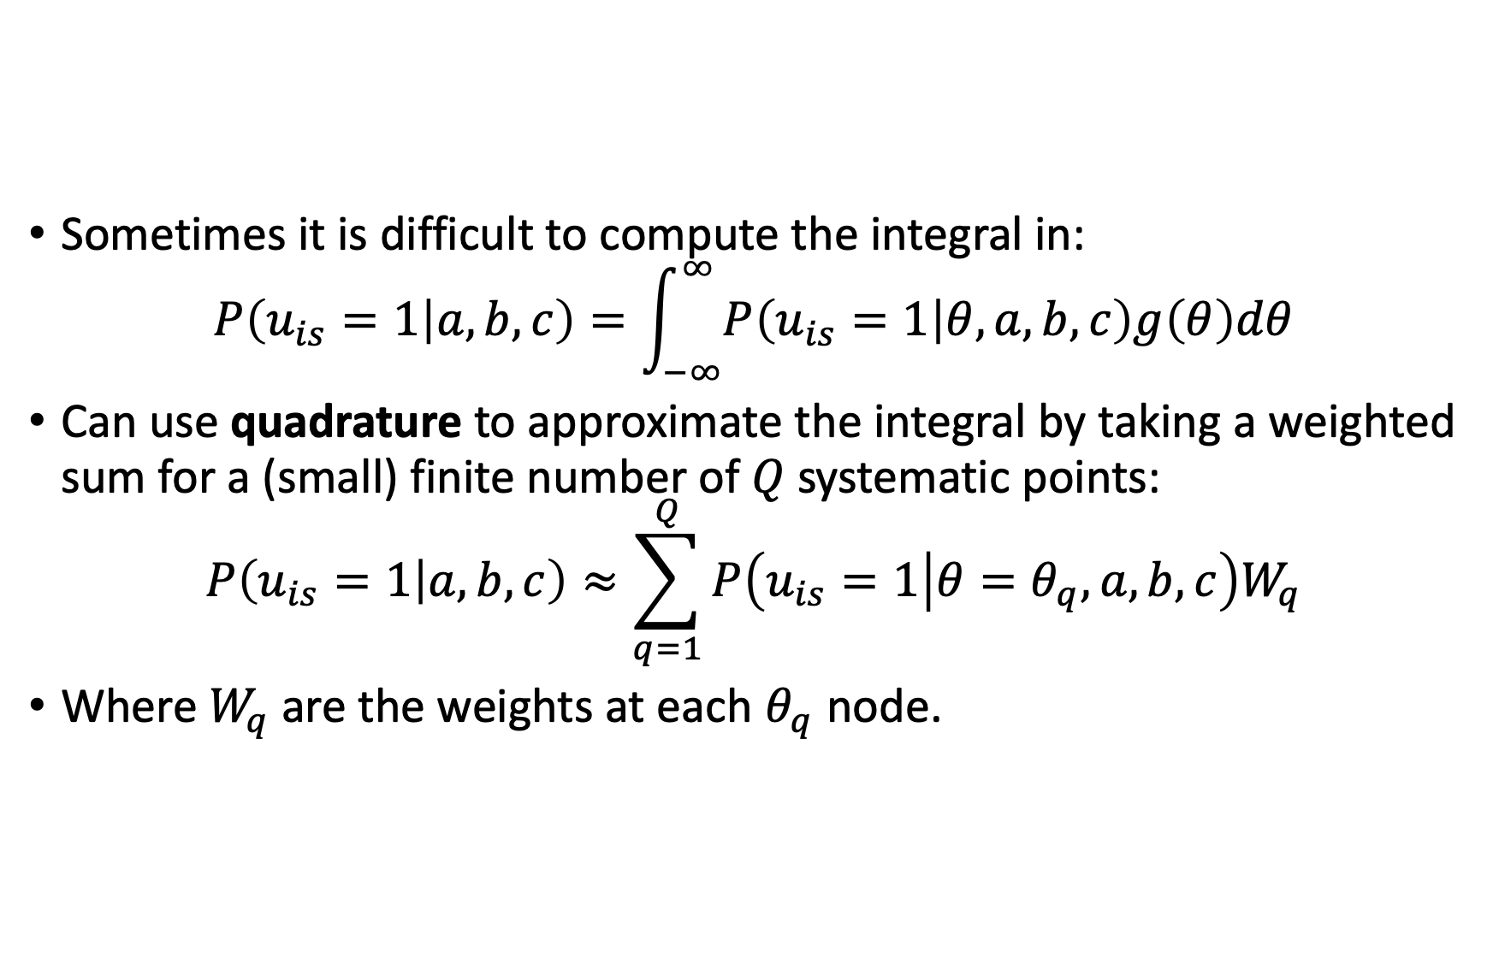
Approximating Integrals
Sometimes it is difficult to compute the integral in:
$$P\left(u_{is}=1 | a,b,c\right)=\int_{−∞}^{∞}{P\left(u_{is}=1 | θ,a,b,c\right)g\left(θ\right)dθ}$$
Can use quadrature to approximate the integral by taking a weighted sum for a (small) finite number of $Q$ systematic points:
$$P\left(u_{is}=1 | a,b,c\right)≈\sum_{q=1}^{Q}{P\left(u_{is}=1 | θ=θ_{q},a,b,c\right)W_{q}}$$
Where $W_{q}$ are the weights at each $θ_{q}$ node.

Slide 19
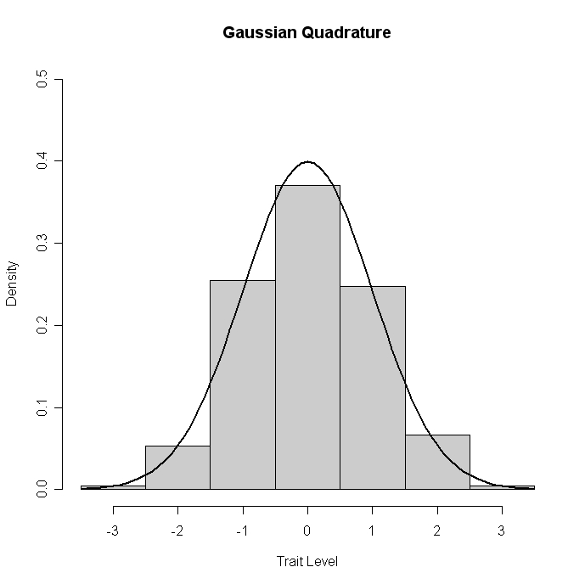


Gaussian Quadrature
A strategy for finding the area under a curve when the integral has no closed form solution. Instead of taking integral of this curve, we sum the areas of the rectangles.
More nodes yields better approximation.
Weight = Density at Discrete node $θ=θ_{q}$ is $W_{q}$.
Discrete Node on Latent Continuum, $θ_{q}$.

Slide 20
Applying Quadrature to Marginal Likelihood Fcn
Say we have 5 items and the response pattern {1,1,0,1,0} = X_{p}
So we can use quadrature to approximate integration over the population distribution of ability, and then compute
Likelihood Function
Log Likelihood Function
Where N_{p} represents the number of respondents with each response pattern.

Slide 21
MMLE/EM Estimation Equations
Ex: Estimation Equation for Item Difficulty in 1PL
N_{p} = number of respondents with each response pattern,
N_{q} = expected number at discrete location on theta distribution
The observed response of person with pattern ”p” to item i. (Since this is for one item, there are only two possible values either a 0 or 1 response, 0 responses don’t contribute)
Term in Brackets: Posterior Probability of being at discrete node q on theta distribution given observed response pattern on test and parameters of item i.
Notes:
Explain source for term in brackets based on application of Bayes Theorem with gaussian quadrature, B&K, p. 159.
Intuition is very tricky: First term is replacing the observed response to item i for examiness at a given value of theta. Second term is replacing what we would predict if the model were true as a function of unknown item par. But what we “expect” (wrt to given item) for an observed value if our posterior prob is right, second term is the expected value.

Slide 22
Interpretation
The IRF for item i evaluated at point q
The expected number of respondents in the population distribution of ability at discrete node q who respond correctly to item i (based on actual data)
The expected number of respondents in the population of ability at discrete node q on the theta distribution (based on model and prior distribution)
Compare to Analogous JML Estimation Equation
Observed Response
Expected item response given provisional value for Theta

Slide 23
Posterior Probabilities?
The MML/EM estimation equations all depend upon this term, the posterior probability of a respondent at a discrete point on the theta continuum conditional on a given response pattern and set of item parameters.
Where does this come from?

Slide 24
Recall Thor
We start with a prior distribution (here, standard normal).
We compute the likelihood based on probability of getting first item right and second wrong, as before.
Now, we combine these two functions (multiply them) to get a weighted combination – the posterior distribution of theta. We now find the max of the posterior, which is close to 1 again, but now a little lower because it is brought in towards the mean 0 of the prior.

Slide 25
Bayes Theorem
P(A|B) = P(B|A)*P(A) / P(B)
Say A = data likelihood and B = theta. Then,
Using Bayes Thm an equivalent expression is
Prior Distribution
Posterior Distribution
Data Likelihood given Theta
Marginal Likelihood Fcn

Slide 26
Posterior Distribution Function
Likelihood Function for a given person across all items on a test (response vector)
Probability density function of ability in the population of respondents (“prior distribution”)
Marginal (unconditional) probability of item response vector (averaged over population of respondents)
Notes:
Denominator in top expression can be interpreted as the unconditional (marginal) probability of the response vector X_s

Slide 27
Quadrature Form of Posterior Distribution
Approximate integration using quadrature approach, condition on discrete values from quadrature nodes, and replace subject specific response vectors with all unique response patterns.
This gets used to determine the expected number of examinees at each point along the ability distribution…”artificial data”
Notes:
Denominator in top expression can be interpreted as the unconditional (marginal) probability of the response vector X_s

Slide 28
Expectation-Maximization Algorithm 1
The E Step (for each item)
Uses Bayes Thm to compute posterior prob distribution for each quadrature node.
Use posterior distribution to predict the expected number of respondents at each theta level (quadrature node/point). [Analogous to that which is predicted by model]
Use posterior distribution and observed item response for each person in sample to predict the expected number of respondents at each theta level (quadrature node/point) that get the item correct. [Analogous to that which is observed in the data]
The M Step (for each item)
Now solve the estimation equations for each item parameter combination.
Use Newton-Raphson algorithm.

Slide 29
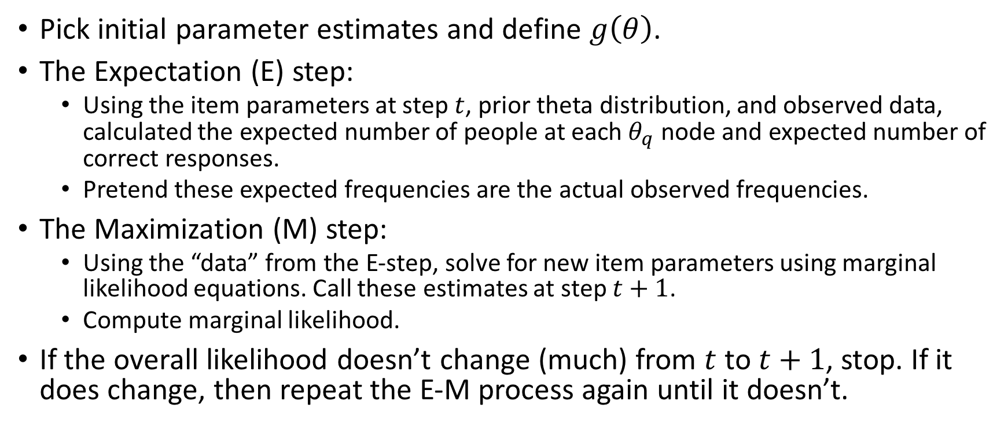
Expectation-Maximization Algorithm 2
Pick initial parameter estimates and define $g\left(θ\right)$.
The Expectation (E) step:
Using the item parameters at step $t$, prior theta distribution, and observed data, calculated the expected number of people at each $θ_{q}$ node and expected number of correct responses.
Pretend these expected frequencies are the actual observed frequencies.
The Maximization (M) step:
Using the “data” from the E-step, solve for new item parameters using marginal likelihood equations. Call these estimates at step $t+1$.
Compute marginal likelihood.
If the overall likelihood doesn’t change (much) from $t$ to $t+1$, stop. If it does change, then repeat the E-M process again until it doesn’t.

Slide 30
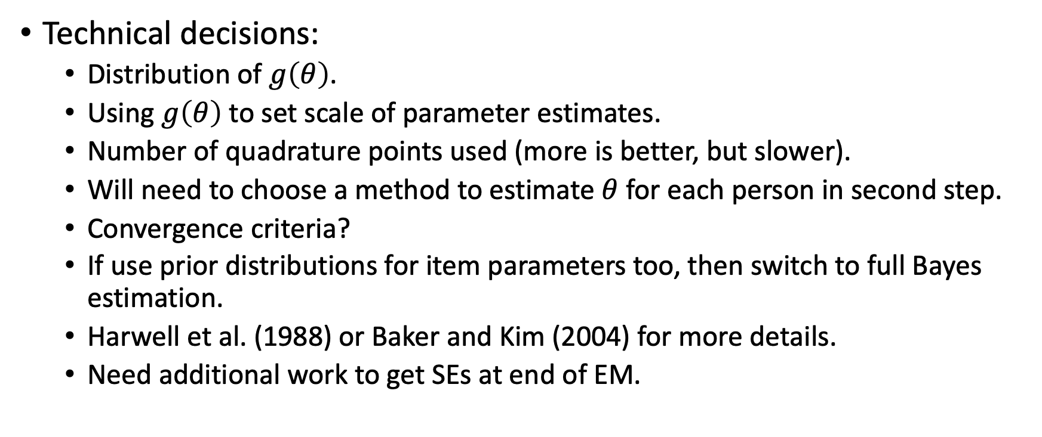
MMLE Notes 1
Technical decisions:
Distribution of $g\left(θ\right)$.
Using $g\left(θ\right)$ to set scale of parameter estimates.
Number of quadrature points used (more is better, but slower).
Will need to choose a method to estimate $θ$ for each person in second step.
Convergence criteria?
If use prior distributions for item parameters too, then switch to full Bayes estimation.
Harwell et al. (1988) or Baker and Kim (2004) for more details.
Need additional work to get SEs at end of EM.

Slide 31
MMLE Notes 2
Pros
Method can work for many IRT models (including MIRT).
Works for long and short tests; better statistical properties than JML.
SEs and likelihoods have better properties than JML.
Cons
Computationally more complex.
Can be slow to converge.
Theta distribution must be pre-specified (though need not be normal).
Need additional techniques to get standard errors.

Slide 32
Conditional Maximum Likelihood
Works only for Rasch models (in fact, it is sort of inextricable from Rasch’s derivation of his model)
Relies on the fact that there is a 1:1 correspondence between total score and theta score for ALL Rasch models.
See Baker and Kim (2004) for details along with my separate ppt presentation.
The eRm() package can do CMLE for Rasch models.

Slide 33
Default Estimation in mirt
The default estimation method in mirt is to use MMLE via the EM algorithm.
Default is to use 61 quadrature points (for any 1-dimensional model). This could be changed using the “quadpts” option (usually best to accept default unless specifying a multidimensional model)
The prior distribution of theta is normal, with mean 0 and SD of 1.
Convergence threshold default is set at .0001 (see “TOL”) or 500 iterations (see “NCYCLE” under “technical”), whichever comes first.
Ex: mod3 <- mirt(cde, 1, itemtype=“3PL”, technical = list(NCYCLES = 2000))
Newton-Raphson (as described in ER) is not the default method for “optimization” (a different “hill-climbing” method (“BFGS”) that works better for surfaces that aren’t necessarily smooth is used. Doesn’t require computation of a second derivative. If you wanted to use NR, specify optimizer=“NR”
See ?mirt for many more details.

Slide 34
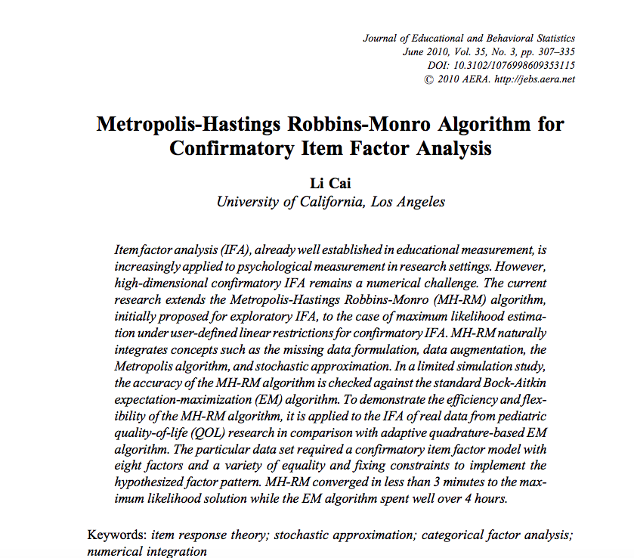
MHRM Estimation
Where this becomes especially relevant is for the estimation of complex multidimensional models.

Slide 35
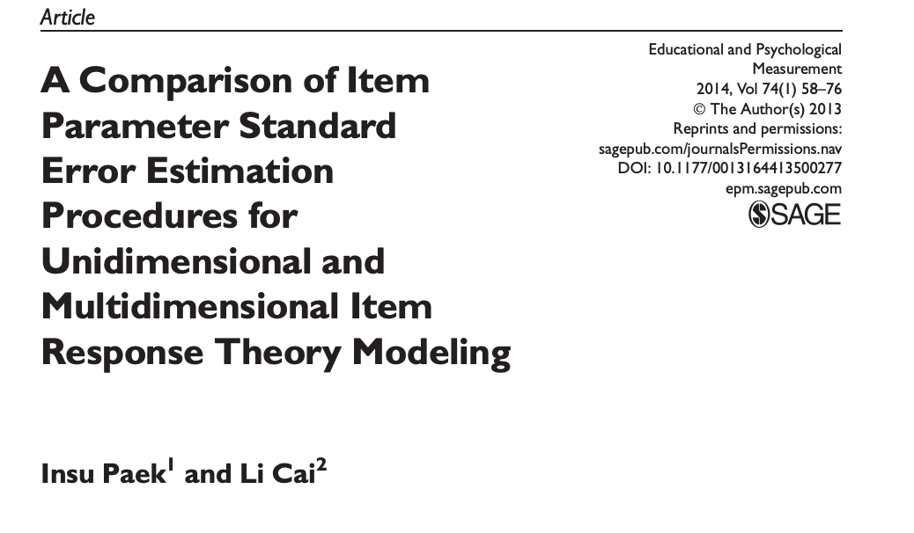
Estimating Item Parameter SEs
Estimation issues provide an active area of ongoing research. (Though how much this matters to practice is sometimes debateable)

